Slide 1

CS109B
Lab 7
Project Setup
Mar 30, 2017

Slide 2
Agenda
Local / VirtualBox setup
AWS setup
(Optional) Spark Setup

Slide 3
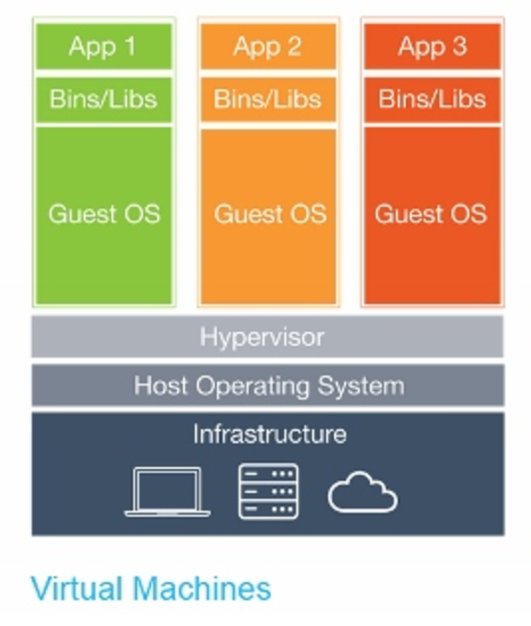
Local Setup - VirtualBox
VirtualBox is virtual machine environment.
http://stackoverflow.com/questions/16047306/how-is-docker-different-from-a-normal-virtual-machine

Slide 4



VM Advantages
All configured for you!
Python, Keras, TensorFlow, Numpy, etc…..
Consistency among team

Slide 5
VM Disadvantages
Big 16 Gb unpacked
Slow ⇒ but the heavy lifting will happen on AWS

Slide 6
Why VirtualBox
Cross platform (Windows, MacOS, Linux)
Free
Alternatives:
Docker, Hyper V are not cross platform
VMware is not free (and even slower)

Slide 7
AWS Setup
The AMI we provide does not contain LaTeX
⇨ All the rest is same config as your local VirtualBox
⇨ Generate PDF on your local machine

Slide 8
Let’s proceed!
See Canvas, Modules, Week 10, Lab 7 for instructions
Editable! Fix mistakes, add more details...

Slide 9
(Optional) Spark Setup

Slide 10
Questions, Comments?

